Slide 2
Final

Slide 4
The final keyword in java is used to restrict the user. The java final keyword can be used in many context.
Final can be:
1.Variable
2.Method
3.Class
Final is a non-access modifier applicable only to a variable, a method or a class.

Slide 6
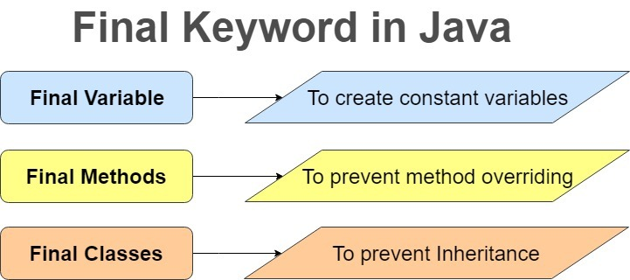

Slide 7
Final Variables –
When a variable is declared with final keyword, it’s value can’t be modified, essentially, a constant.
This also mean that you must initialize a final variable. It is good practice to represent final variables in all uppercase, using underscore to separate words.
You can initialize a final variable when it is declared. A final variable is called blank final variable, if it is not initialized while declaration.
Three ways in which you can initialize final variables –
Initializing when you declare it.
Initializing in constructor.
Initializing in the instance initialization block (IIB)

Slide 8
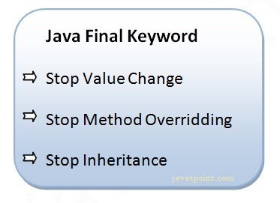
Java final variable
If you make any variable as final, you cannot change the value of final variable(It will be constant).
Example of final variable
There is a final variable speed limit, we are going to change the value of this variable, but It can't be changed because final variable once assigned a value can never be changed.

Slide 9
Output:Compile Time Error
class Bike9{
final int speedlimit=90;//final variable
void run(){
speedlimit=400;
}
public static void main(String args[]){
Bike9 obj=new Bike9();
obj.run();
}
}//end of class
Output:
Compile Time Error
There is a final variable speed limit, we are going to change the value of this variable, but It can't be changed because final variable once assigned a value can never be changed.

Slide 10
Difference between Normal variable and Final variable –
The only difference between a normal variable and a final variable is that we can re-assign value to a normal variable but we cannot change the value of a final variable once assigned.
Hence final variables must be used only for the values that we want to remain constant throughout the execution of program.

Slide 11
2) Java final method
When a method is declared with final keyword, it is called a final method.
A final method cannot be overridden.
Which means even though a sub class can call the final method of parent class without any issues but it cannot override it.
We must declare methods with final keyword for which we required to follow the same implementation throughout all the derived classes.

Slide 12
class Bike{
final void run()
{
System.out.println("running");}
}
class Honda extends Bike{
void run(){System.out.println("running safely with 100kmph");}
public static void main(String args[]){
Honda honda= new Honda();
honda.run();
}
}
Output:
Compile Time Error

Slide 13
Final Classes –
When a class is declared with final keyword, it is called a final class.
A final class cannot be extended(inherited).
2 reasons to make a class final –
One is to prevent inheritance, as final classes cannot be extended.
To create immutable class (like the predefined String class). You can not make a class immutable without making it final.

Slide 14
final class Bike{}
class Honda1 extends Bike{
void run(){System.out.println("running safely with 100kmph");}
public static void main(String args[]){
Honda1 honda= new Honda1();
honda.run();
}
}
Output:
Compile Time Error

